Slide 1

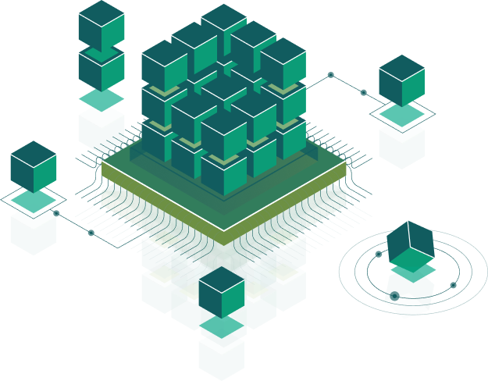
Dependency
management
Speaker:
Taras Aftanashchuk
Notes:
Introduce course and speacers

Slide 2
Simple web project
https://gist.github.com/chrisvfritz/bc010e6ed25b802da7eb
Notes:
what we need to build some web project?
index.html
maybe some css (to scss)
maybe some js ()

Slide 3

npm registry
npm
yarn
package.json
package-lock.json
npm i (npm install)
npm run ...
package.json
yarn-lock.json
yarn
yarn runn ...
Example: https://github.com/koajs/examples/blob/master/package.json
npm install --save-dev vs npm install --save
Notes:
other useful command

Slide 4

version Must match version exactly
>version Must be greater than version
>=version etc
<version
<=version
~version
^version
Notes:
versions ~,^

Slide 5
Build project
Gulp
Webpack
grunt
...

Slide 6
KISS
Notes:
mahmud style

Slide 7

Thank you!

